Slide 1
Synthetic Data
for
Bias Detection & Fairness Audits

Slide 2
The Core Problem
Real-world datasets inherit historical biases (racial, gender, socio-economic).
Data sparsity for minority groups leads to discriminatory models.

Slide 3
The Solution (Synthetic Data)
Algorithmically generated data that mimics real data distribution without exposing Personally Identifiable Information (PII).
Provides a secure sandbox for experimentation without privacy violations.

Slide 4
Objectives of the Presentation
Understand the role of synthetic data in uncovering model bias.
Explore generation methodologies and practical algorithmic auditing applications.

Slide 5
Strategic Advantages

Slide 6
Demographic Balancing
Artificially scaling up representation for underrepresented groups to fix native skew.

Slide 7
Historical Bias Removal
Decoupling protected attributes (e.g., race, gender) from target outcomes in training targets.

Slide 8
Counterfactual Testing
Testing how a model's prediction flips when changing only a single demographic attribute of an individual.

Slide 9
Privacy-First Auditing
Empowering external third-party auditors to probe models without accessing real user data.

Slide 10
Methodologies & Techniques

Slide 11
Generation Architectures
Generative Adversarial Networks
(GANS)
A machine learning framework where two neural networks
a generator and
a discriminator
compete in a zero-sum game.
Variational Autoencoder
(VAE)
a type of artificial neural network used for generative artificial intelligence.
Bayesian Networks
a map that shows how different things are connected

Slide 12
Differential Privacy (DP)
  Injecting mathematical noise to guarantee individual records cannot be reverse-engineered.

Slide 13
Causal AI Integration
  Modeling cause-and-effect paths to understand why a bias occurs in algorithmic decisions.

Slide 14
Edge-Case Augmentation
  Synthesizing extreme or rare scenarios that rarely appear in historical logs to stress-test safety limits.

Slide 15
The Audit Lifecycle

Slide 16
Data Assessment & Mapping
  Identifying protected classes and hidden proxy variables that leak discrimination.

Slide 17
Creating the Audit Benchmark
  Generating statistically sound "gold-standard" reference datasets for evaluation.

Slide 18
Measuring Fairness Metrics
  Applying quantitative standards: Disparate Impact (Four-Fifths Rule) and Equalized Odds.

Slide 19
Remediation & Retraining
  Using synthetic datasets to retrain models and correct discovered structural disparities.

Slide 20
Remediation & Retraining
  Using synthetic datasets to retrain models and correct discovered structural disparities.

Slide 21
Challenges & Future Outlook

Slide 22
Fidelity vs. Complexity Trade-Offs
  The risk of over-sanitizing synthetic data and losing real-world behavioral complexities.

Slide 23
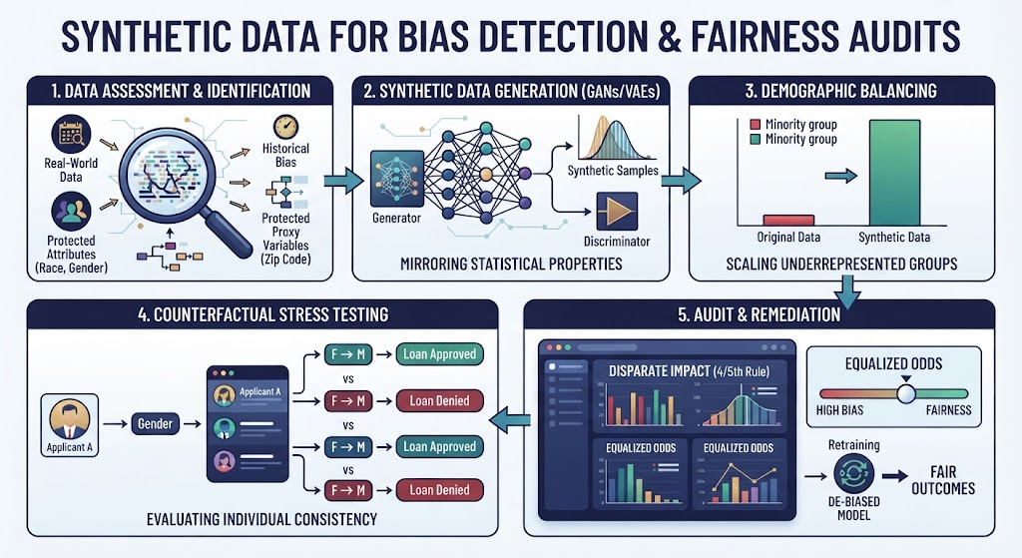
Conclusion

